Slide 1
A Novel Blood-Based Biomarker That Distinguishes Estrogen-Negative (ER–) Solid Tumors In Patient Samples
Srinidi (Sri) Mohan
Associate Professor
Department Of Pharmaceutical Sciences And Administration
Westbrook College Of Health Professions – School Of Pharmacy
smohan@une.edu I 207.221.4058

Slide 2
Why Focus On ER–?
ER–is typically
More aggressive histologically
More common in younger individuals
Associated with BRCA1 mutations (hereditary breast cancer)
Linked to ethnic disparity
Associated with worse prognosis, and two-fold mortality
ER– (breast cancer) disease includes
Triple-Negative Breast Cancer (TNBC)
Inflammatory Breast Cancer (IBC)
Aggressive Serous Ovarian Carcinoma
Currently
no blood-based biomarker is recommended
(by ASCO, NCCN)
for ER– cancer screening and/or
treatment outcome measurement

Slide 3
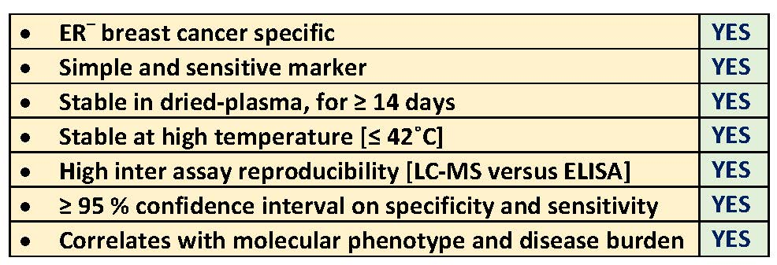
Our Marker Competitive Advantage
U.S. Utility Patent
10,073,099
U.S. Utility Patent
11,009,507
Mohan et al., 2016, 2017, and 2018, Amino Acids
Mohan et al., 2019, Journal of Immunological Methods
Mohan et al., 2020, Advances in Medical Sciences

Slide 4
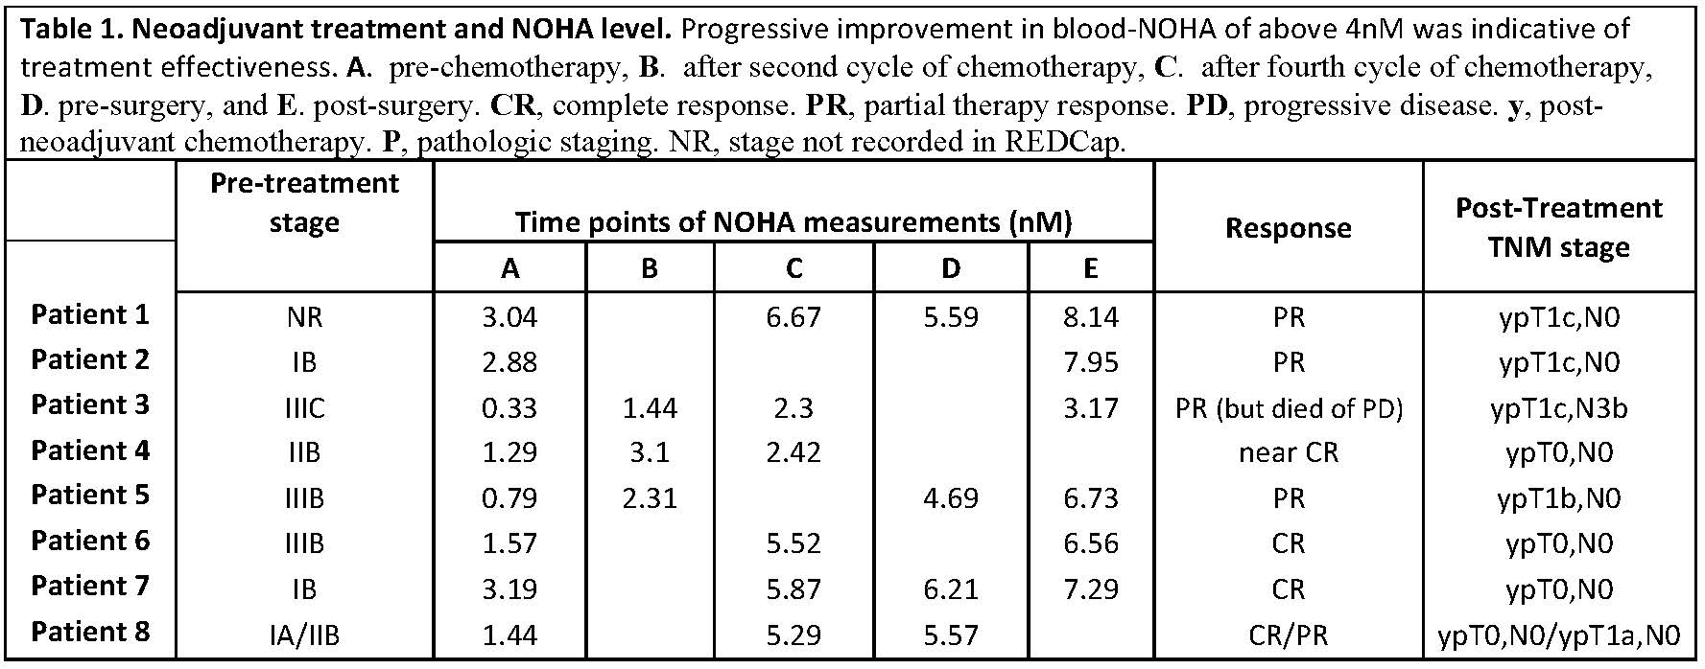
TNBC NOHA Response To Neoadjuvant Therapy
NOHA response value above 4.0 = favorable therapy response
NOHA response value below 4.0 = disease onset, or no response to therapy

Slide 5
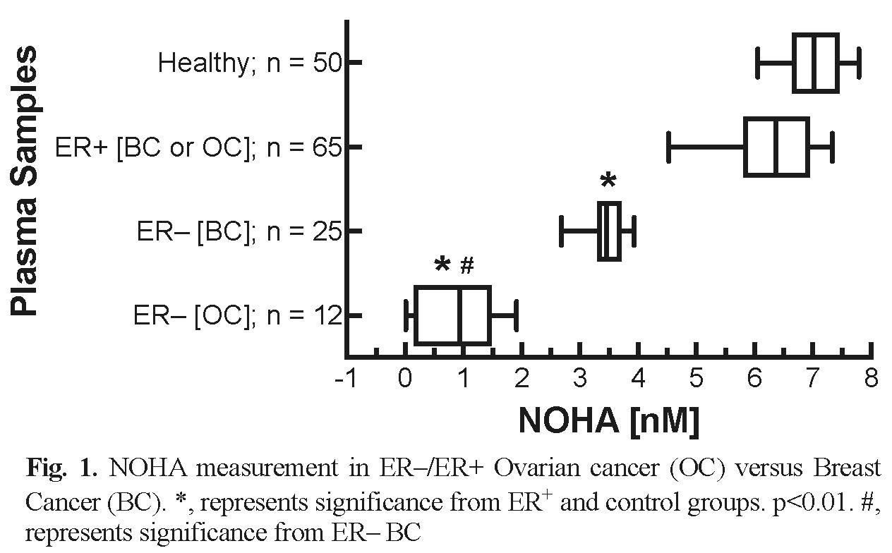
NOHA Distinction Between ER– Breast Versus Ovarian Cancers
Next Steps
Early Detection
National – In women newly diagnosed with BRCA mutation-positive breast cancer (Underway., funded by Maine Cancer Foundation)
Global – Pilot study (Underway) ; Multi-site U01 grant (Submitted)
Treatment outcome and therapy effectiveness – extended clinical study
Favors – personalized medicine/therapy, Avoids over-treatment
Fig. 1.

