Slide 1

Tasting the Tides: Student Innovation at the Nexus of Nutrition and Ocean Health
UNE SeaMade Nutrition Bar Presenters
Matthew Duddy, M.S., Sea Farm Manager
Lisa Herschbach, Ph.D. Director, Center for Innovation & Entrepreneurship
Jayden Schoppee ‘27, Athletic Training and Nutrition (B.S., M.S.)
Maine Nutrition Council: Exploring New Landscapes of Food
October 3, 2025

Slide 2
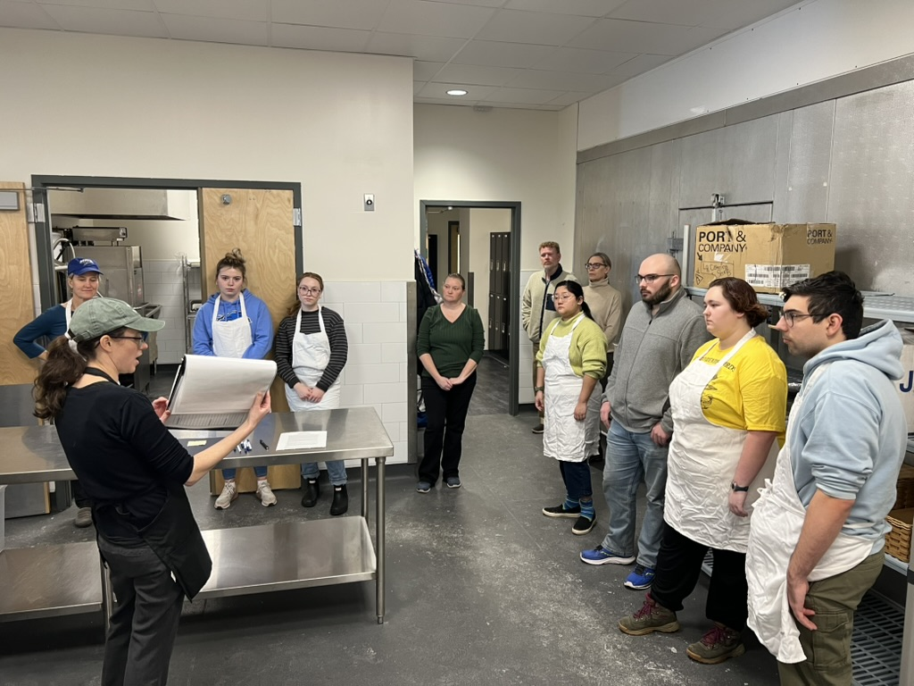
Tasting the Tides: Presentation Overview
Why is seaweed a new land(ocean) scape of food?
Innovation, research, and student leadership at UNE
Project review AY 2024-25
Seaweed farming at UNE
How we make the bars
Nutritional analysis of the SeaMade Bar
AY 2025-26 goals
Challenges, opportunities, and key takeaways
Q&A

Slide 3
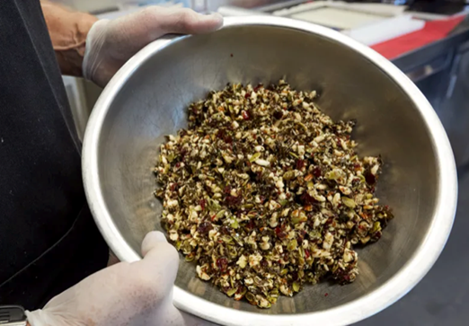
Tasting the Tides: Why is seaweed a new land(ocean)scape of food?
Farmed seaweed can help feed the planet and fight climate change at the same time
A versatile food source with high nutritional value; showing up more and more in grocery stores and restaurants
Farmed seaweed requires no land, freshwater, fertilizer, or pesticides
Reduces coastal pollution and creates healthier marine habitats by improving water quality
Like terrestrial forests, seaweed forests sequester carbon by absorbing CO2 from oceans during photosynthesis
Protects our coasts: healthy seaweed farms can help reduce the impacts of ocean waves, slowing coastal erosion
Notes:
Board of Trustees (March 6, 2025) and at the Innovation Showcase (April 28, 2025).

Slide 4
Tasting the Tides: Why a kelp nutrition bar at UNE?
A shining example of UNE’s distinct educational model: student-led innovative, experiential learning
Gift of SeaMade embraced with enthusiasm by university leadership, faculty across the disciplines, and students
Project supported through the Center for Innovation and Entrepreneurship, Center for North Atlantic Studies, and private philanthropic donation to create opportunities for UNE students to learn how to design create solutions to real-world challenges
Opportunity to extend the reach of our robust aquaculture research platform and seafarms to support food production
Also to leverage the potential for Nutrition Program’s teaching kitchen as an experimental laboratory
Exemplifies UNE’s motto: “Innovation for a Healthier Planet”
Notes:
Board of Trustees (March 6, 2025) and at the Innovation Showcase (April 28, 2025).

Slide 5
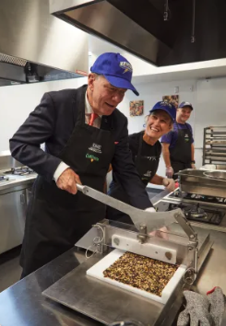
Tasting the Tides: Project Review AY 2024-25
In August 2024, founders of the SeaMade Seaweed Company gifted the bar to UNE
That fall, first production of bars took place in UNE’s Teaching Kitchen where students learned the process
An innovation team of 10 students, working together with subcommittees and faculty mentors, set goals for sourcing ingredients, production, marketing, and project management
Tested new recipes (blueberries and pecans)
Shared progress with Board of Trustees and at Innovation Showcase
In the spring of 2025 we harvested sugar kelp from UNE seaweed farm
We also submitted Food and Fuel License Applications including:
Retail Food Establishment and Mobile Vendor licenses (sales)
Commercial Food Processor license
In summer 2025 we collaborated with UNE Communications and to design UNE branded wrapper
Notes:
Board of Trustees (March 6, 2025) and at the Innovation Showcase (April 28, 2025).

Slide 6
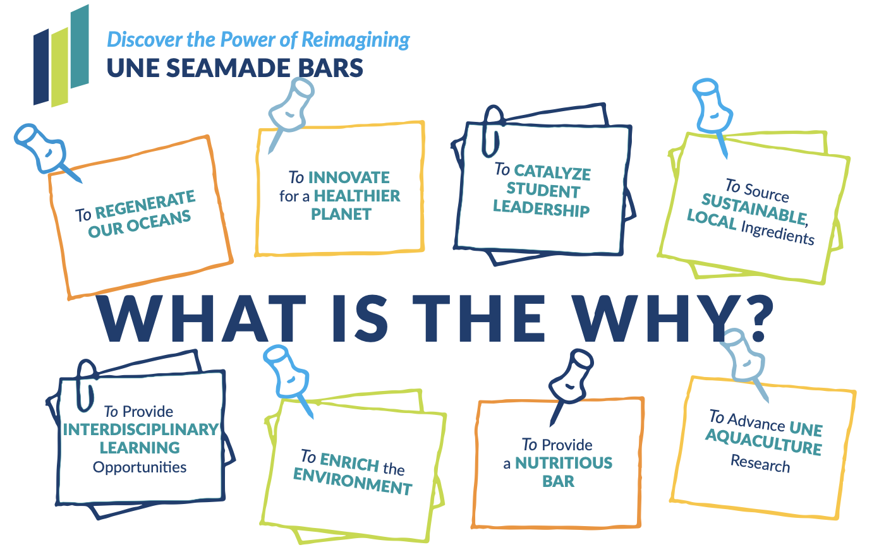
Tasting the Tides: Student Visioning Excercise

Slide 7
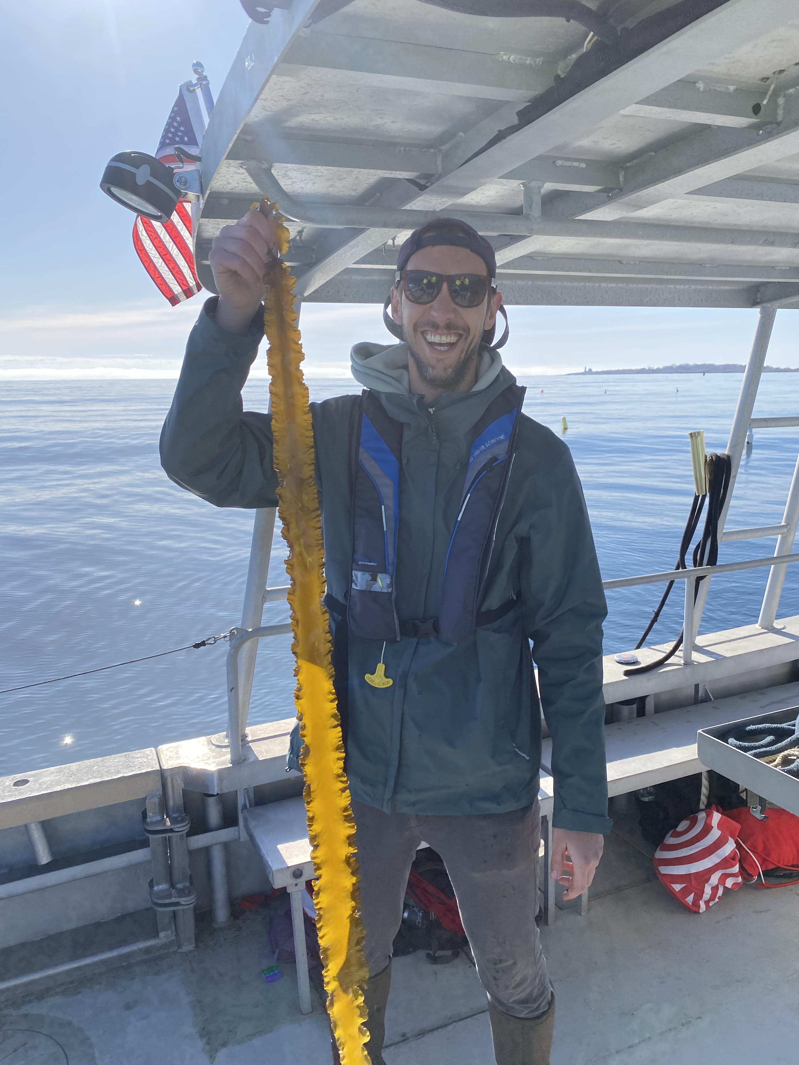
Tasting the Tides: Seaweed Farming at UNE
Meet the Farm Manager
Background in marine and experiential education. BS from the University of Maine at Farmington, MS from Lesley University in Cambridge.
Two decades of marine focused learning in Southern Maine and Massachusetts
Staff member at University of New England in the School of Marine and Environmental Programs
Started managing the university sea farms in the summer of 2024.

Slide 8
Sea Farms at UNE
The Farms
There are 3 different unique sea farm sites owned either by the university or Dr. Carrie Byron, the faculty member most closely associated with farm operations.

Slide 9
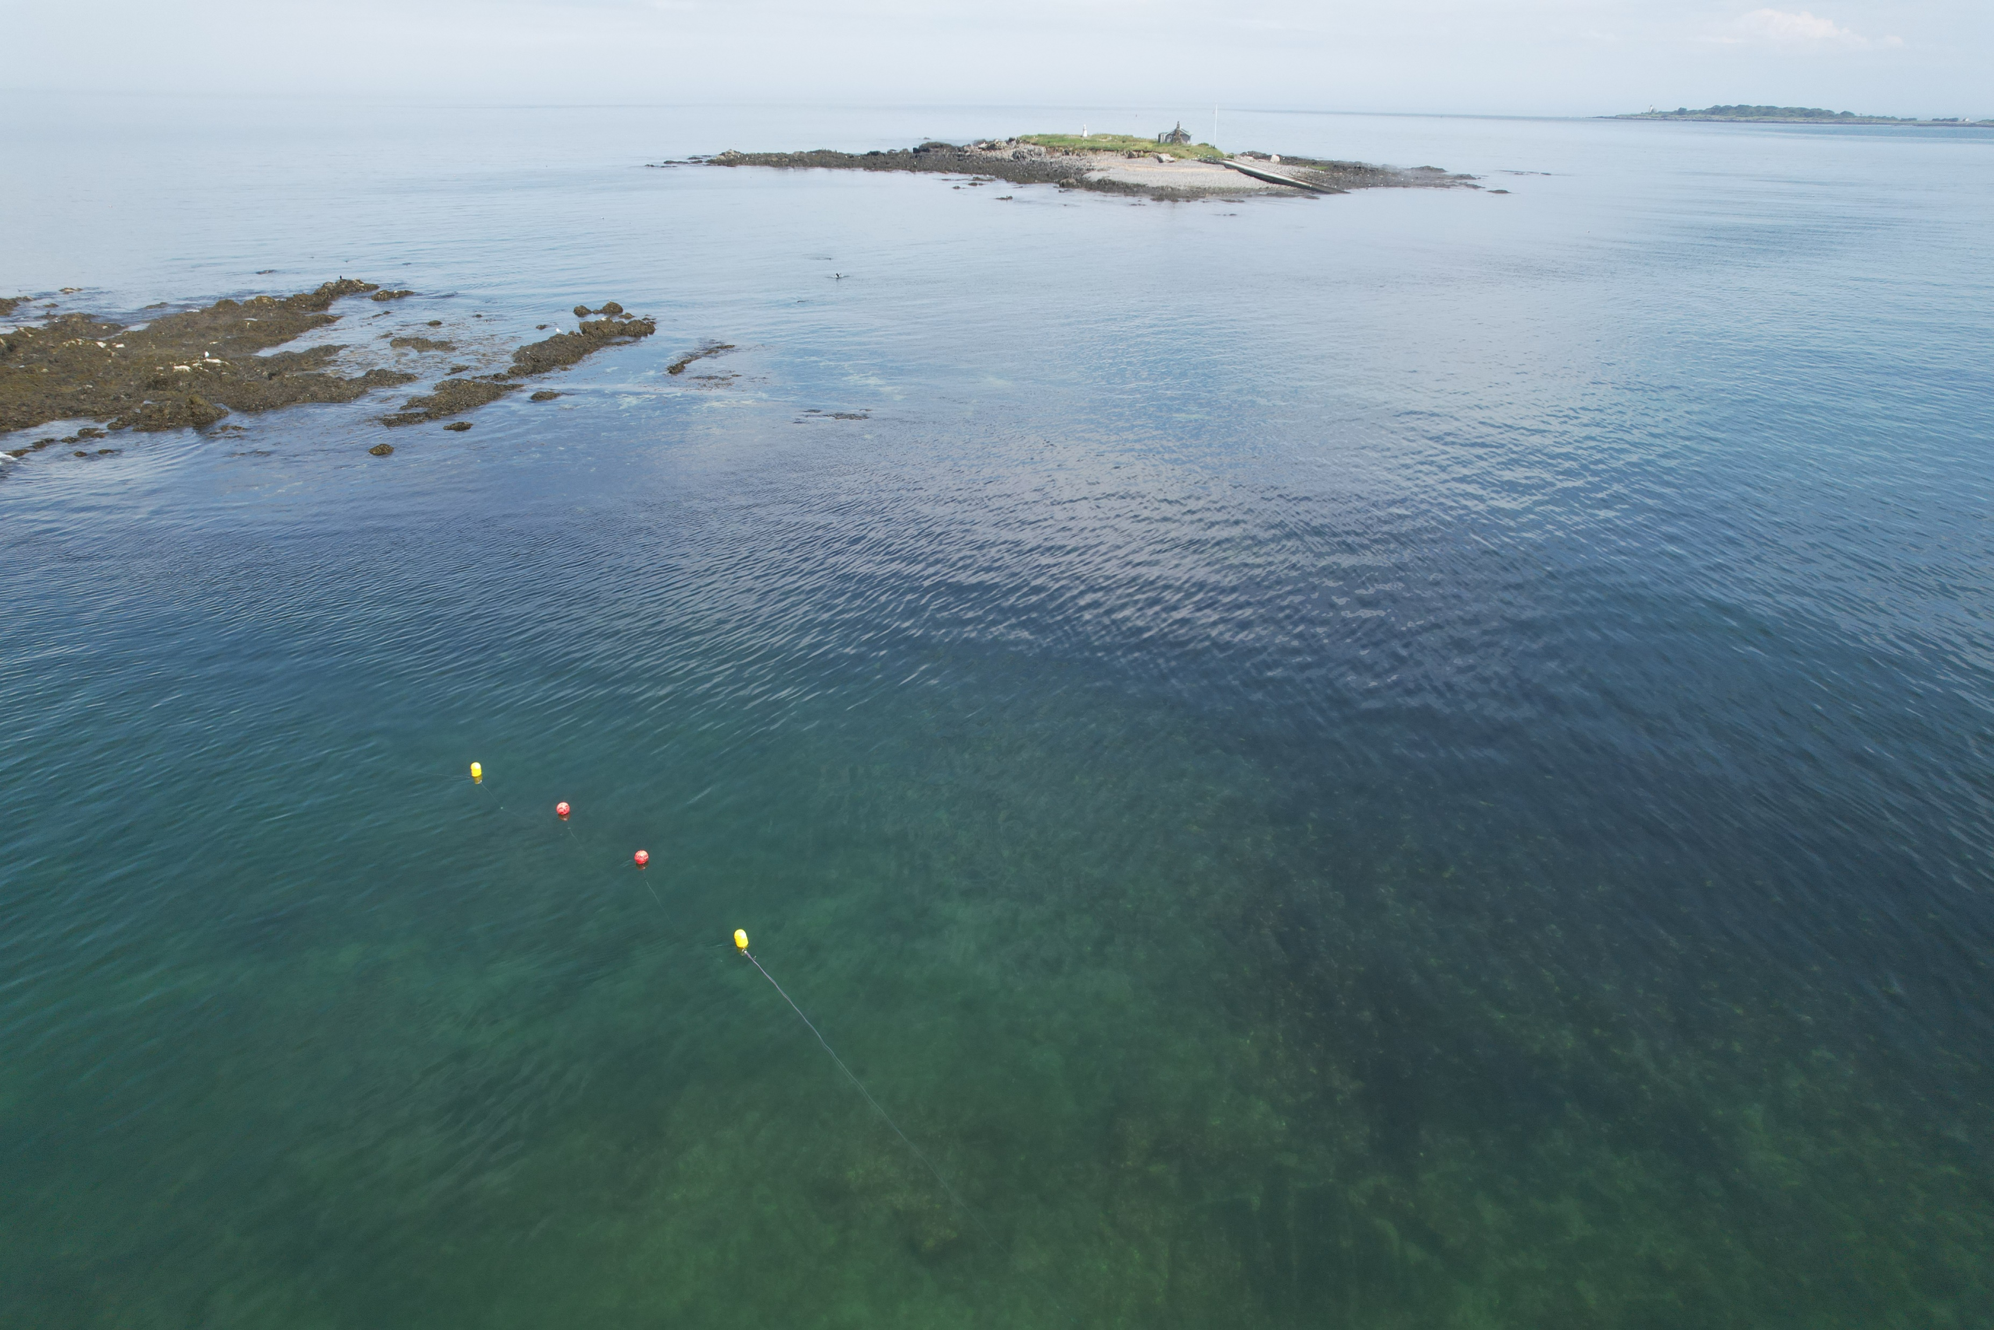
Sea Farms at UNE
Site one: CBYR224 on the shore side of Ram Island (Limited Purpose Aquaculture)
This farm was designed by an undergraduate research student in conjunction with UNE staff members. The farm deployment and all of the data was student driven and generated.

Slide 10
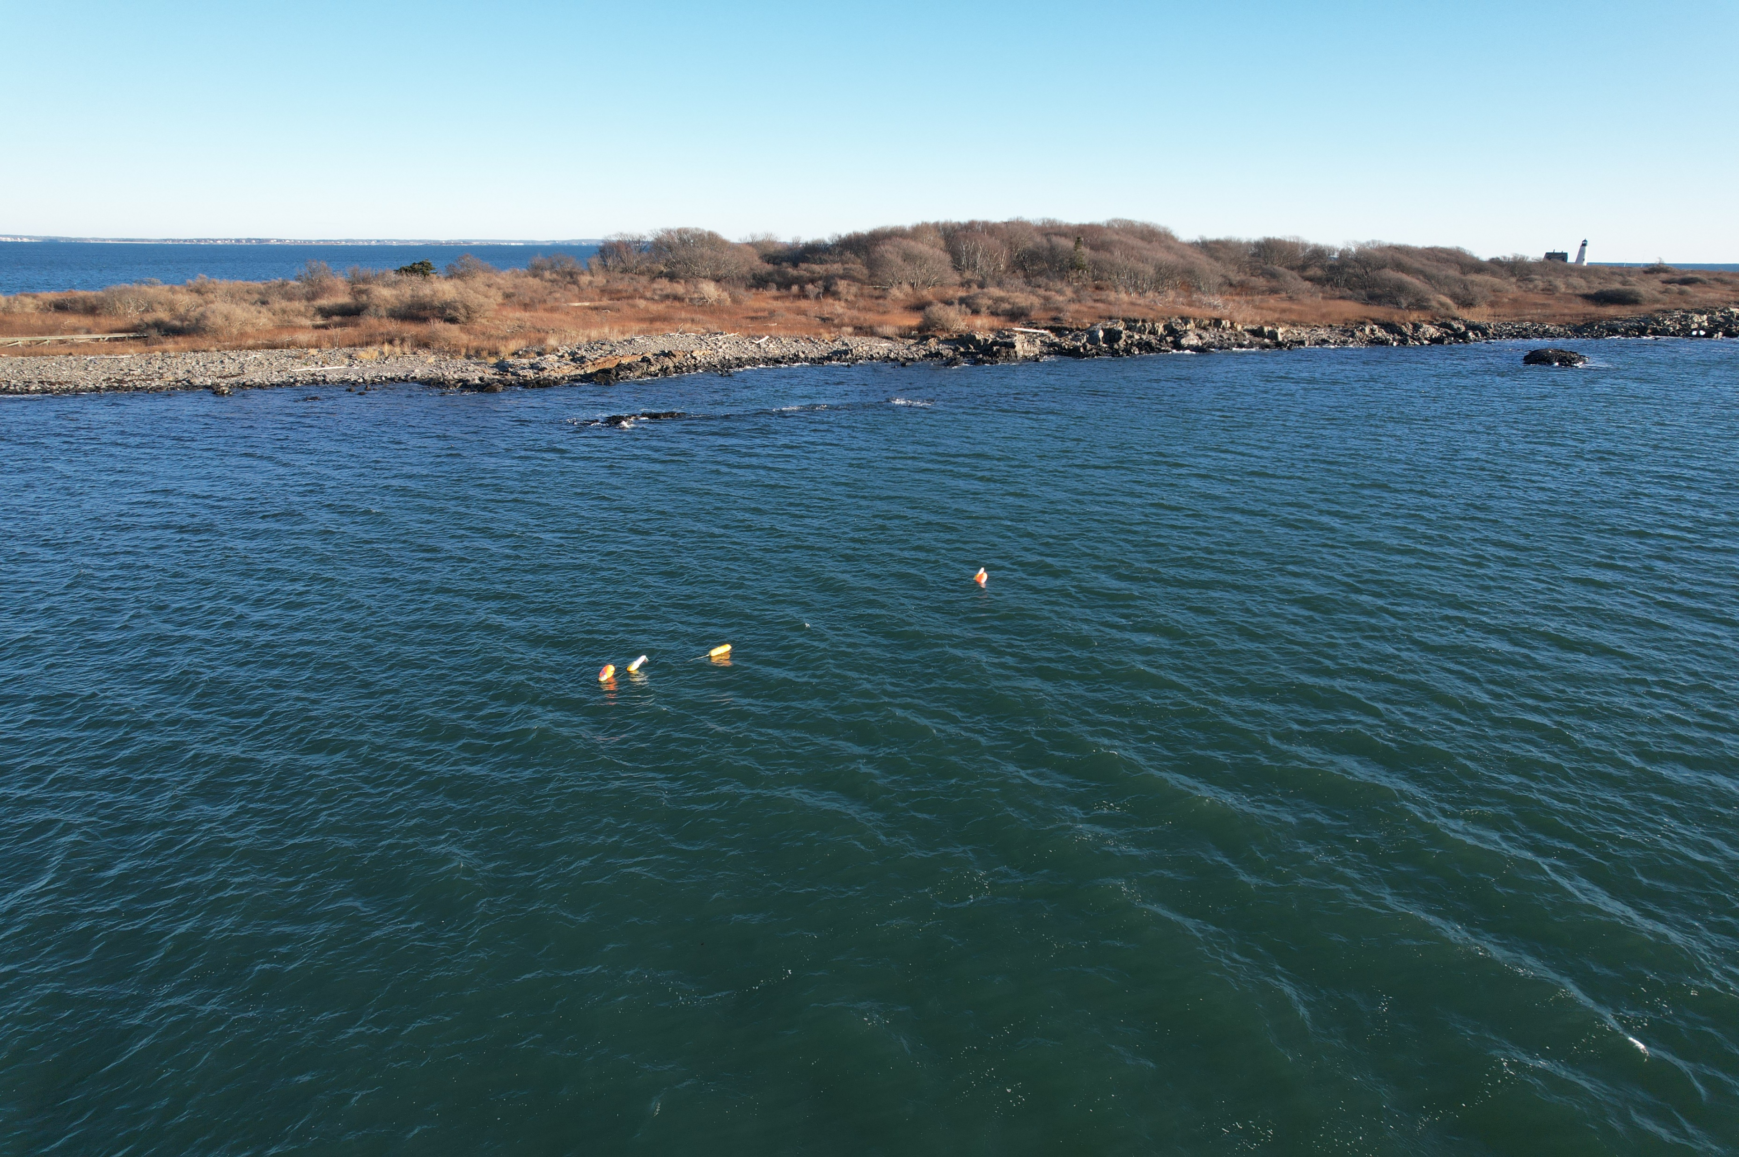
Sea Farms at UNE
Site two: CBYR121 next to Wood Island (Limited Purpose Aquaculture)

Slide 11
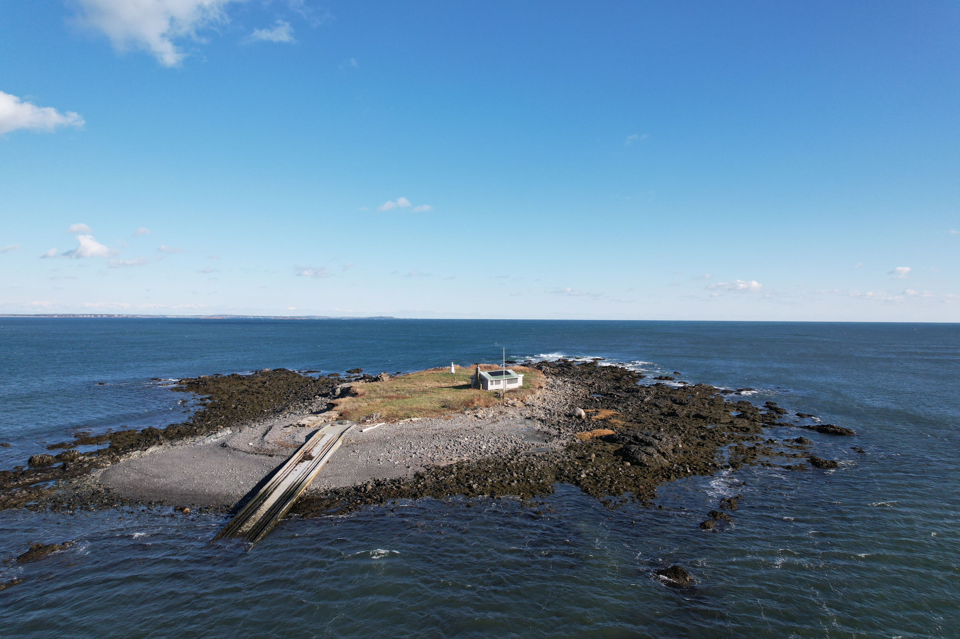
Sea Farms at UNE
Site 3: SACORIX (Experimental site)

Slide 12
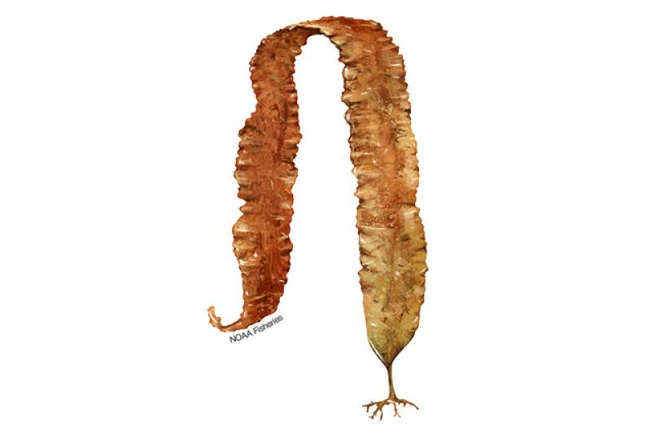
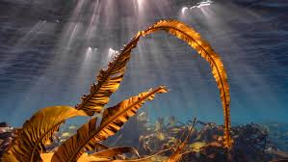
Sea Farms at UNE
What do we grow?
Sugar Kelp (Saccharina latissima)
Alaria (Alaria esculenta)

Slide 13
Sea Farms at UNE
How do we grow the seaweed?
We use a farm array that has two 100’ long horizontal grow lines that are attached to large sea farm marker buoys at each end.
This is a view of the farm from above.

Slide 14

Sea Farms at UNE
How do we grow the seaweed?
Sea Farm
Sea Farm
This is the view of the farm from the side

Slide 15
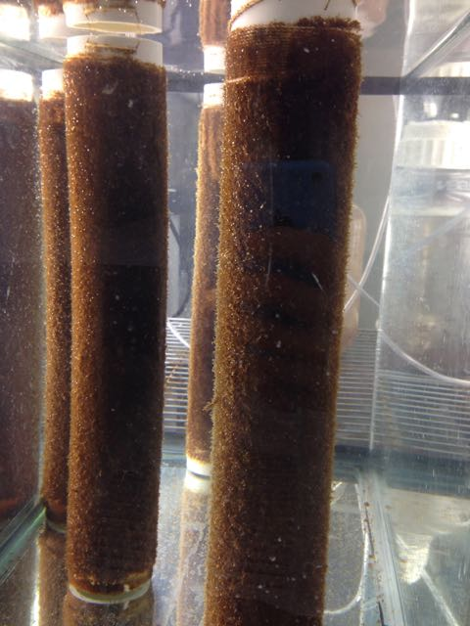
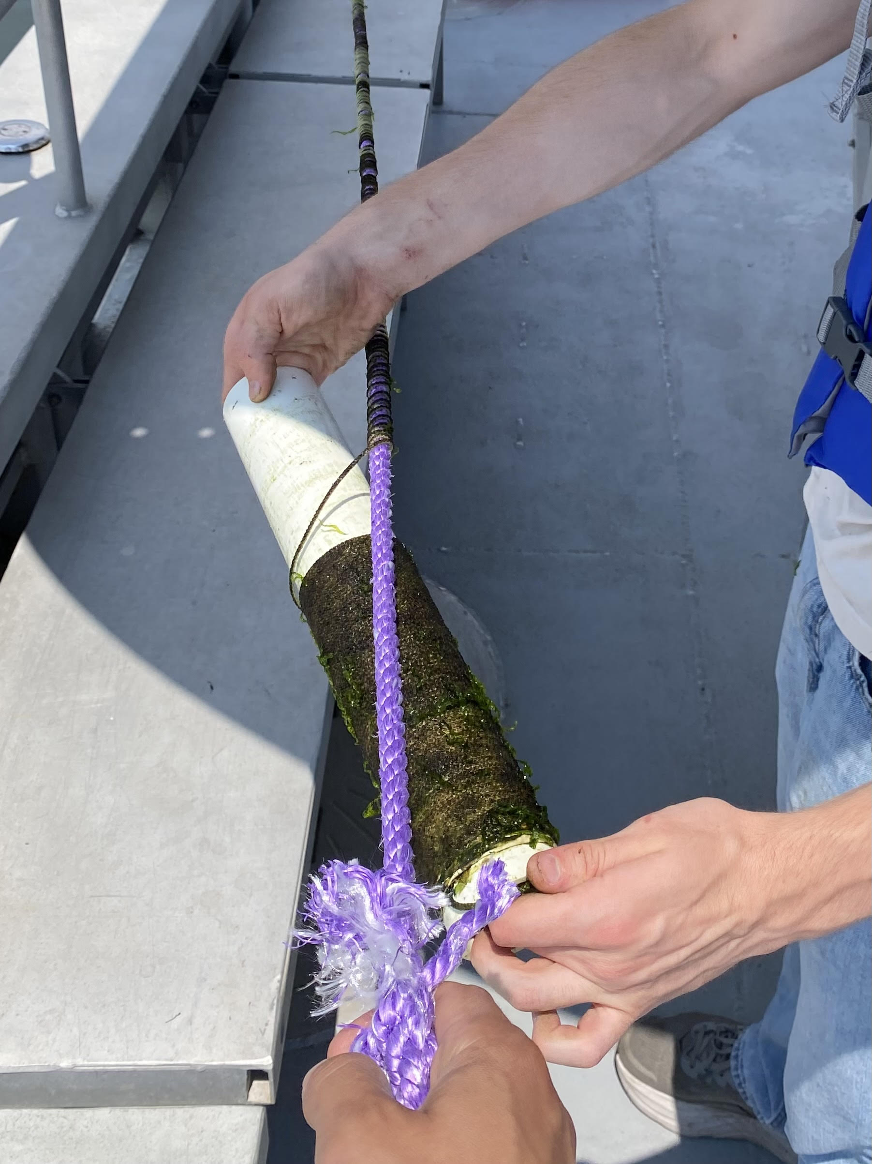
Sea Farms at UNE
Seeding the Lines

Slide 16
Sea Farms at UNE
The growing season on the UNE Sea Farms takes place between October 14th through May 16th
This growing season is designed to accommodate recreational boaters and lobstermen in the area.
Sugar Kelp and Alaria also grow best in water temperatures between 10-15 degrees Celsius (50-59 degrees Fahrenheit)
We opportunistically monitor the farm growth with small vessels and drones depending on the weather conditions.

Slide 17
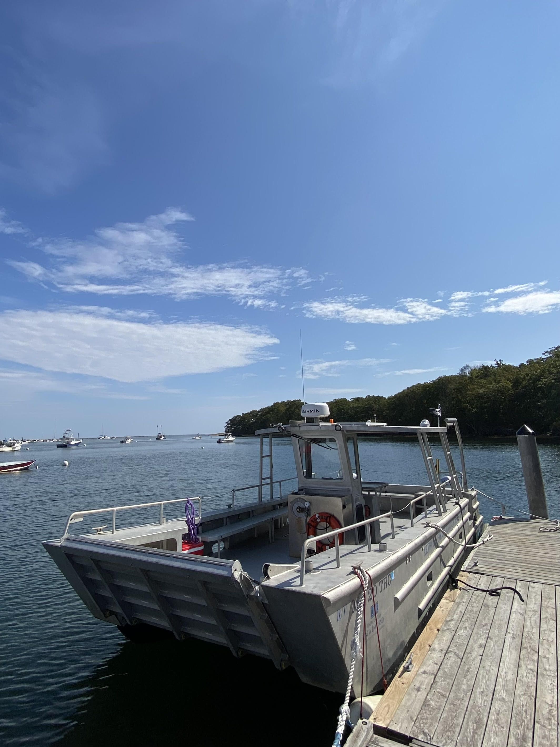
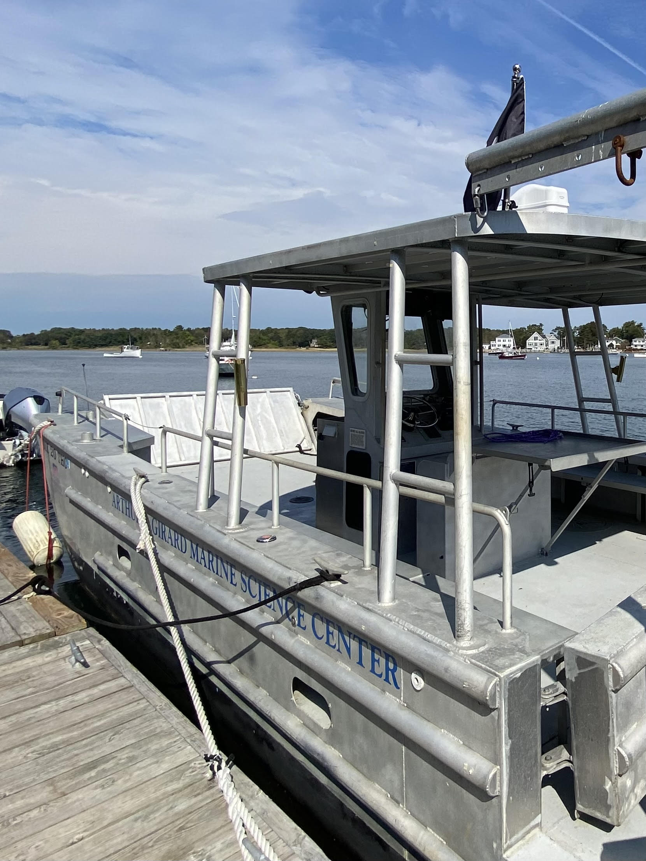
Sea Farms at UNE
Harvest Season

Slide 18
Sea Farms at UNE
The farmed seaweed is loaded on to a truck that travels to a large dehydrator in Brunswick. At this point the SeaMade team takes over!

Slide 19
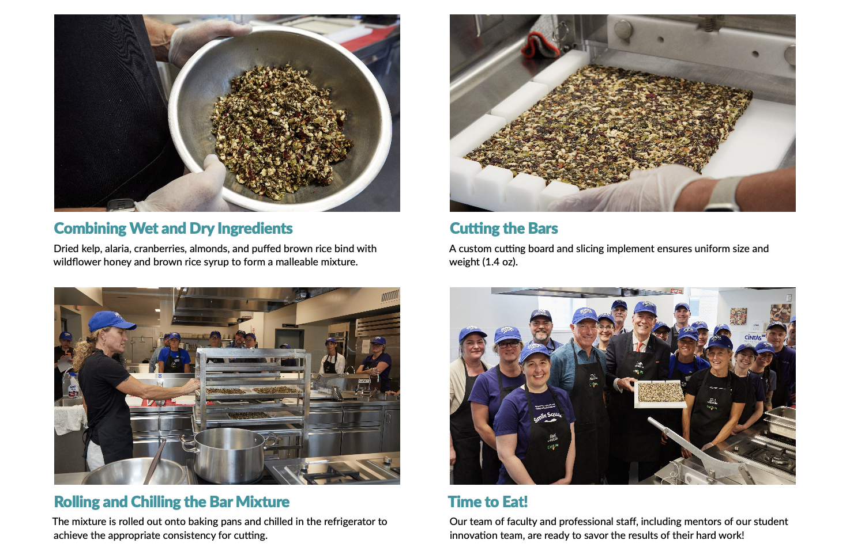
Tasting the Tides: SeaMade Bar Making

Slide 20
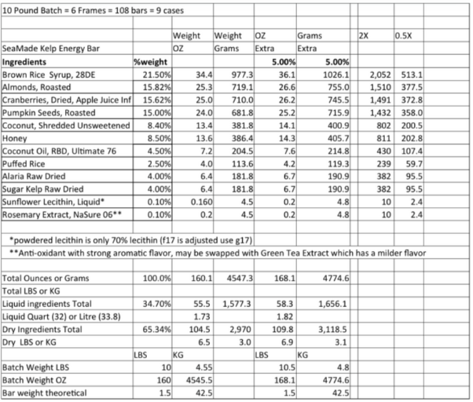
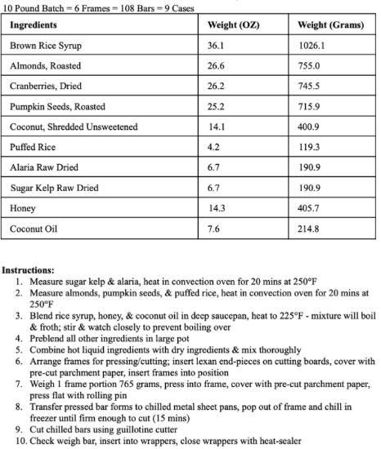
SeaMade Bar: Original Recipe vs Modified Recipe

Slide 21
Nutritional Analysis of SeaMade Bar
Sugar & Alaria Kelp
Iodine for thyroid function and metabolism
Calcium for bone health
Vitamin K for heart health
Protein for cell growth and maintenance
Locally sourced and sustainably grown
Almonds and Pumpkin Seeds, Roasted, Unsalted
Vitamin E for antioxidant properties
Monounsaturated fats for heart health
Fiber for gut health
Contributes to texture and flavor profile
Cranberries Dried, Sweetened in 100% juice
Vitamin C and antioxidants for immune health
Fiber for gut health
Acts as a natural sweetener
Puff Rice Cereal
Iron for healthy blood maintenance
Fiber for gut health
Contributes to texture
Coconut and Coconut oil
Fats for energy
Manganese for metabolism
Vitamin E for antioxidant properties
Contributes to flavor profile
Honey
Antioxidants for immune health
Acts as a sweetener and binder
Locally sourced
Notes:
Full nutritional analysis of the SeaMade bar made by UNE’s Nutrition Students

Slide 22
Tasting the Tides: AY 2025-26 Goals for SeaMade Bar
Source additional bar ingredients from our campus land and waters (seaweed, honey, blueberries, other?)
Explore new recipe)
Produce ~ 5,000 UNE SeaMade bars and develop plan for distribution at UNE
Develop Business Plan, including detailed budgets for ingredient, production, and wrapper costs at different scales
Obtain a Commercial Food Processor License for the Decary Teaching Kitchen so we can sell the bars (not just distribute them)

Slide 23
UNE SeaMade Bar Opportunities, Challenges, and Takeaways
Interdisciplinary, collaborative, student-driven innovation drives successful learning
Trust students to “choose their own adventure” and balance with structured supports and mentorship
Seek opportunities to integrate innovation with curriculum as well as co-curricular programs
Create space for cross-disciplinary work (nutrition with business, marine science, materials science, etc.)
University-industry partnerships hold great promise, and their impact is amplified through research and teaching
Seaweed as a holds great potential for the future of food and as a driver of human and planetary health
We need additional innovations in aquaculture and food preservation to secure future success
The American palate still needs to learn to appreciate seaweed
Exciting work remains!

Slide 24
New Branding: The UNE Community Weighs In
In collaboration with UNE Communications, we designed new wrapper inspired by our campus topography and using UNE colors
The UNE community was invited to vote on their preference

Slide 25
We have a winner!
Option A is the winner!
Questions?

